Slide 1

Gene Frequencies and
Linkage Disequilibrium
M.J. Stear
University of Glasgow Vet School

Slide 2
Aims
Gene Frequencies
Hardy-Weinberg Equilibrium
Linkage Disequilibrium

Slide 3
Use of gene frequencies
Genetic architecture
Population structure
Evolution

Slide 4
Gene Frequencies
Not the phenotype frequency
Each locus has two alleles
If codominant (both alleles visible)
  count

Slide 5
Gene Frequency
Dominant and recessive alleles
  Allele A frequency p
  Allele B frequency q
Assume random mating
Then homozygous frequency = q²

Slide 6
Random mating
 | A1 Frequency p | A2 q Frequency q
A1 Frequency p | p² | pq
A2 Frequency q | pq | q²

Slide 7
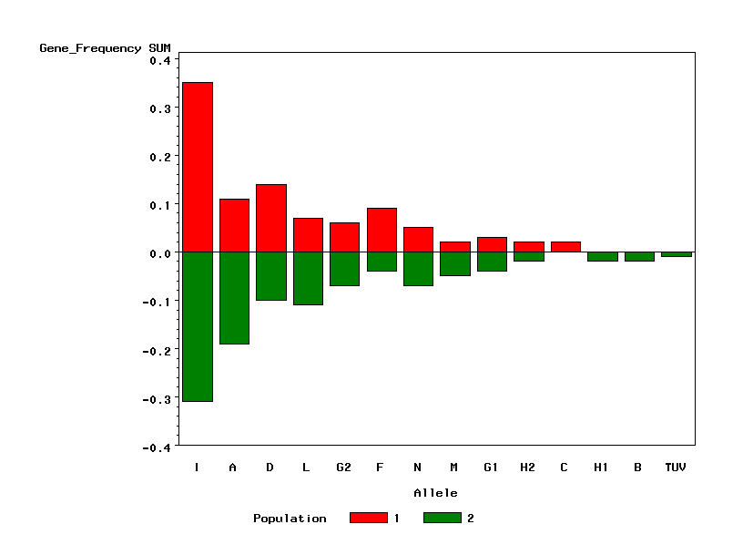
MHC-DRB1 frequencies in two Scottish Blackface flocks

Slide 8
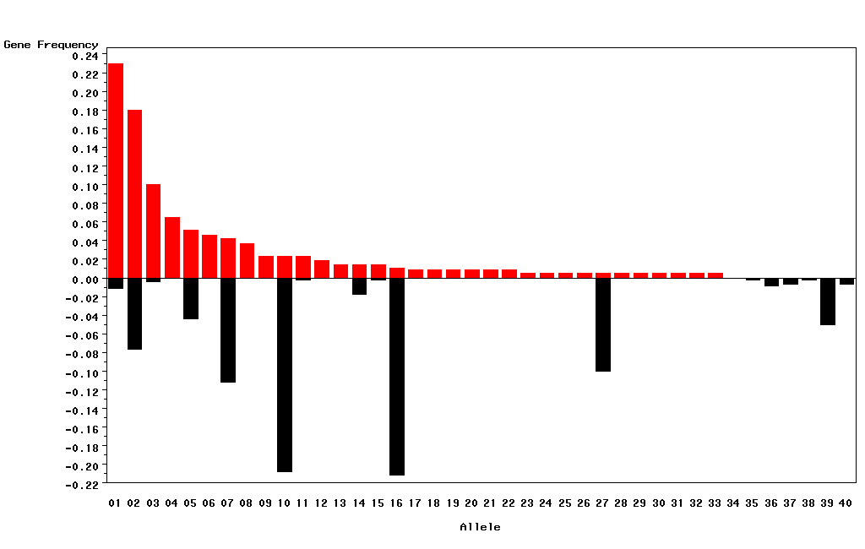
MHC-DRB1 frequencies in Scottish Blackface and Texel sheep

Slide 9
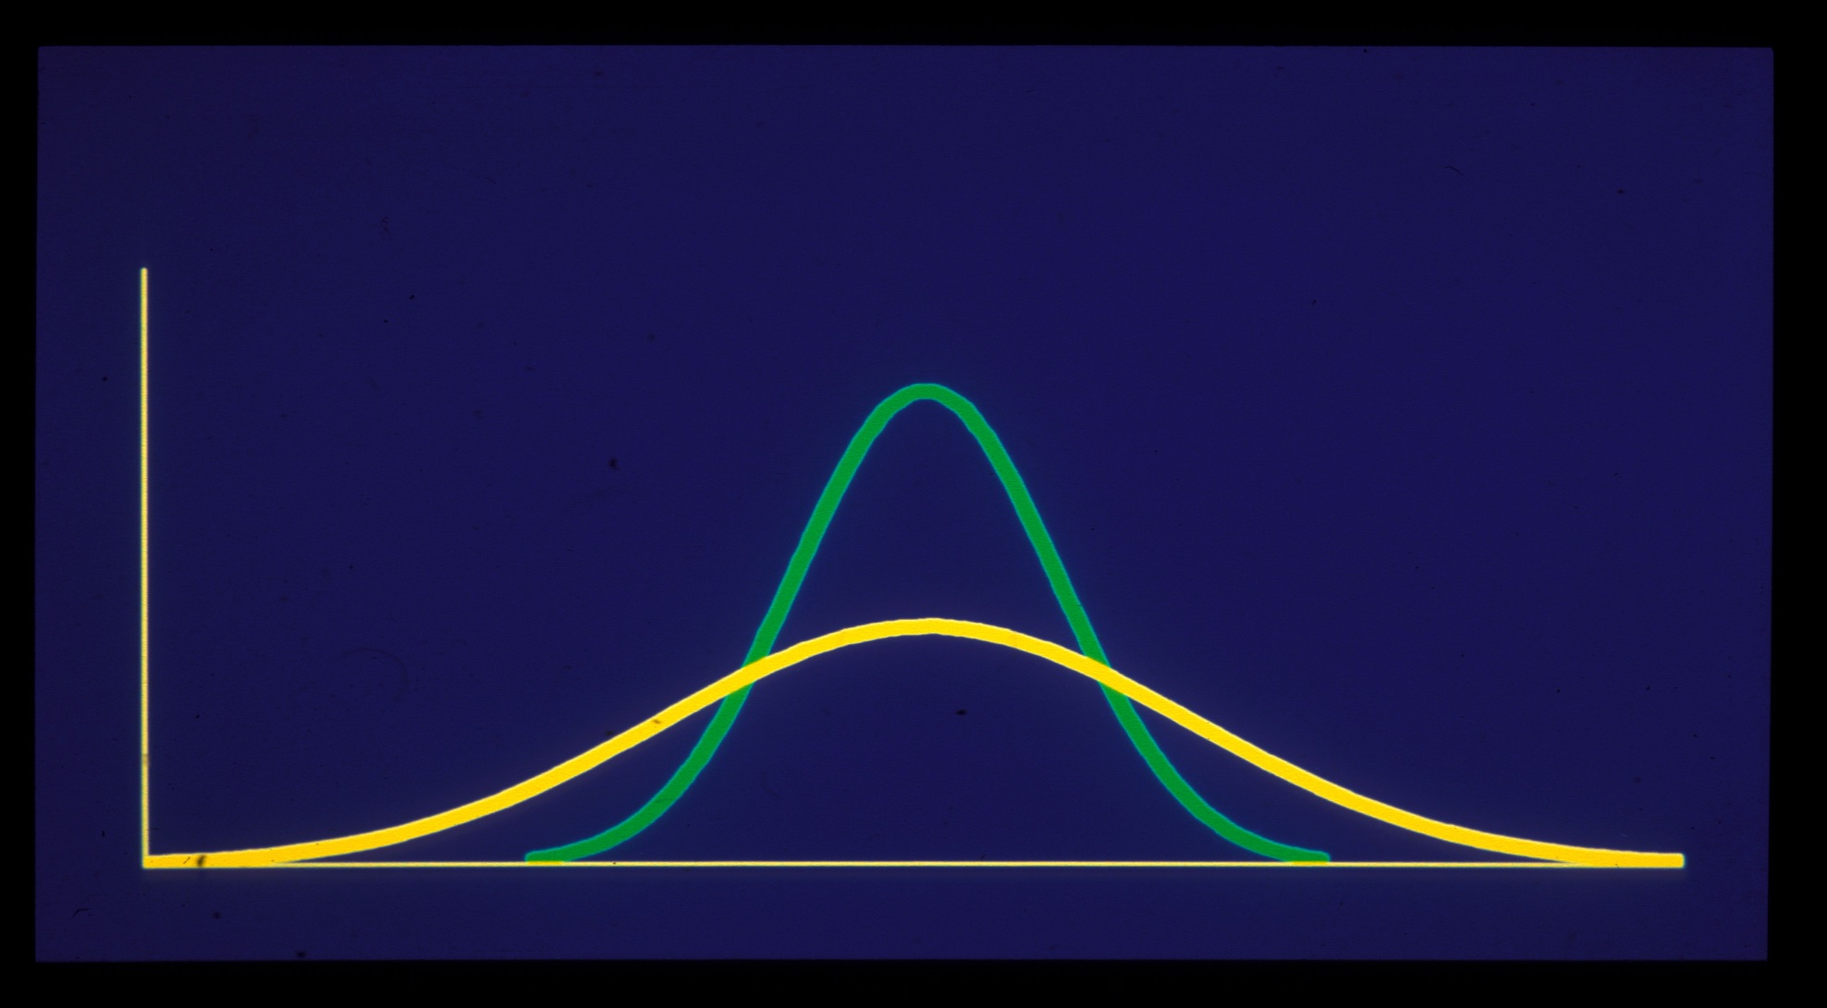
Variance

Slide 10
Measures of dispersion
Variance σ²
Standard deviation σ
Standard error of the mean σ/√n

Slide 11
Estimating precision of gene frequencies
Maximum Likelihood
  Binomial or multinomial
Numerical resampling
Bayesian methods

Slide 12
Total Variance of Gene Frequencies
Within population
  binomial or multinomial
Across populations
  Beta-binomial or Multinomial-Dirichlet

Slide 13
Hardy-Weinberg Equilibrium
Large
Randomly breeding
No mutation
No migration
No selection

Slide 14
Tests for HW Equilibrium
D = P(aa) – P(a)²
Chi-Square test Σ(o-e)²/e
Likelihood ratio tests
Exact tests

Slide 15
Linkage Disequilibrium
Gametic association
Departure from random association of alleles at different loci
Many measures
  D’ r

Slide 16
Measuring Linkage Disequilibrium known gametes
For alleles A and B at two loci
Compare gametic frequency p_{AB}
to product of allele frequencies p_{A and} p_{B}
D_{AB} = p_{AB}- p_{A}p_{B}
D_{AB} is the disequilibrium coefficient

Slide 17
Linkage disequilibrium
D_{AB} influenced by allele frequencies.
  Many corrections exist
D’_{AB} = D/D_{max}
  D>0 D_{max} = min(p_{notA}p_{B}, p_{A}p_{notB})
  D<0 D_{max} = max(-p_{A}p_{B}, -p_{notA}p_{notB} )
R = D/√(p1p2q1q2)

Slide 18
Linkage Disequilibrium
Chi-square tests
Likelihood ratio tests
Exact tests

Slide 19
Composite genotypic disequilibria
A1B1/A2B2 or A1B2/A2B1 ?
Composite tests exist

Slide 20
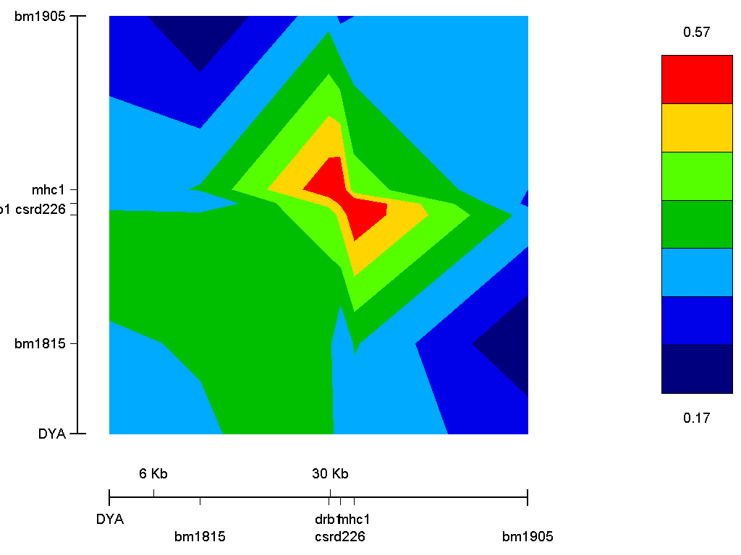

Slide 21
Linkage disequilibrium influenced by
Molecular markers
Gene frequencies
Recombination
Mutation
Selection

Slide 22
Linkage disequilibrium influenced by
Population structure
Population size
Population history
Migration admixture

Slide 23
Haplotype Structure
Blocks of high LD
Separated by recombination hotspots

Slide 24
Uses of Linkage Disequilibrium
Population structure
Population history
Identify disease genes

Slide 25
Summary
Gene Frequency
Variance
Hardy-Weinberg
Linkage disequilibrium

